Slide 1
Insurance Specialty Group Asset Protection Program
Notes:
Single Line Title

Slide 2
Overview of Insurance Specialty Group LLC
Began operations in 1999 exclusively underwriting residential home builders
Dedicated to providing residential homes builders with a comprehensive Risk Management and Loss Control System combined with broad form CGL insurance
Written over $700 mm of residential home builder premium
Approach is to surround the builders’ with solid contracts and move their legal liability from tort law (litigation) to contract law
Implement dispute resolution which is conciliation and arbitration protected by the Federal Arbitration Act

Slide 3
Benefits of Arbitration
This APP arbitration agreement is an “all disputes” arbitration agreement, the broadest possible under the law.
The arbitration agreement does not merely cover Warranty claims, but non-warranty claims as well.
It covers every possible claim which could be alleged by a homeowner against the builder, its subcontractors, suppliers, design professionals and agents,
Including construction defect claims, fraud, intentional torts, unfair and deceptive practices, statutory violations, and all other legal theories of recovery.
The U.S. Supreme Court has held that there is no state law claim, which is immune from arbitration under an arbitration agreement governed by the FAA.

Slide 4
Published Decision on Arbitration Clause – APP Client
Mercedes Homes, Inc. v. Rosario __ So.2d __, 2006 WL 436046 (Fla.App.2 Dist. 2006.)
In the first published decision dealing with the current HBW arbitration agreement, the Florida Court of Appeal reversed the trial court and ordered the homebuyers and their minor child to arbitrate all of their claims against their builder for construction defects, toxic mold and bodily injuries from toxic mold. The court concluded that the HBW arbitration agreement confers jurisdiction upon the arbitrator to decide which claims he is empowered to arbitrate, and that it is immaterial whether those claims are covered under the Warranty or not.

Slide 5
Feeding Frenzy
“
The legal profession wants to form a symbiotic relationship with your business. You provide the exposed flesh. They’ll provide the butchers.
”
Builder Magazine – September 2001
Notes:
Quote Slide

Slide 6
Contracts: Avoiding TORT and Litigation
BLUEPRINT TO PROTECT YOUR BUSINESS
Notes:
Multi-line Title with subtitle

Slide 7
The implied warranty laws [TORT] are the friend of lawyers; not businessmen. They lead to a jury of homeowners, who don’t know a rebar from a Hershey bar.
Notes:
Aside/Quote

Slide 8
Issues in the Homebuilding Industry
Significant increase in construction defect claims and related litigation [caveat venditor replaced caveat emptor]
Builders are liable for Implied Warranty Laws in most states
TORT or CONTRACT. Your only two options.
Insurance/warranty companies eliminating critical coverage: Soil movement and construction defects from the work of subcontractors [two prime examples]
Notes:
Bullet List with Header

Slide 9
Legal Issues in the Home building Industry
Who determines the “Legal Liability” of builders and contractors? Contract and an industry professional? Or a jury of homeowners?
Mediate, arbitrate or litigate?
Some states are ruling that faulty workmanship will be paid from the builders assets and not the insurance policy!
Caveat emptor has been gone for decades.
Notes:
Bullet List with Header

Slide 10
General Liability Insurance
insurancespecialtygroup.com
Notes:
Branded Page Single Line Title

Slide 11
General Liability Insurance How does it work?
Provides legal liability protection for “premise operation” claims which “occur” during construction, i.e., bodily injuries, resulting damages, etc.
Provides legal liability protection for claims arising after the home is sold, which “occurs” during the policy period – typically construction defect issues.
Distinguish from what a WARRANTY covers.
Notes:
Bullet List with Header

Slide 12
General Liability Insurance What else?
Three ADDITIONAL CONTRACTS are also needed
Subcontractor agreements
Sales agreement; be sure dispute resolution in sync with warranty contract
Third-party warranty to replace implied warranty law/tort exposures
These contracts are critical to protecting the assets of home builders from TORT/lawyers/litigation!
Notes:
Bullet List with Header

Slide 13
Warranties and Insurance from a professional in the business
This is not vanilla, commodity insurance
It is not your Grandmother’s homeowners
All warranties are not created equal
All insurance is not created equal
Specialist or Generalists? Use a SPECIALIST.
Beware of companies who care more about protecting their assets; and not so much, your assets (language and exclusions are critical)
Notes:
Bullet List with Header

Slide 14
Transfer of Risk to Subcontractors and Vendors
Obtain a signed subcontractor agreement from all subcontractors which contains the following:
Hold harmless / indemnity agreement
Insurance requirements which provide financial backing to indemnity agreements
Waiver of subrogation
Arbitration agreement
Obtain Certificates of Insurance before work has begun
Require that subcontractors carry minimum general liability insurance limits of $1,000,000
Notes:
Bullet List with Header

Slide 15
Defining Your Legal Liability with a Written Warranty
General liability policies respond to builder’s legal liability
Builders are liable for “Implied Warranty Laws” unless replaced by an express written warranty
Insurance companies have exited residential construction due to difficulty in determining the contractors “legal liability”; or worse; they limit THEIR exposure; increasing yours
Notes:
Bullet List with Header

Slide 16
Comprehensive Sales Contract with every homeowner
Have your attorney draw up the sales contract to ensure you are protected (versus a Realtor® form. Guess who that one protects?)
Does the sales contract have arbitration language?
The signed sales contract is key documentation; be sure it is consistent with the warranty
Email me; or go to NAHB/contracts new web site [all contracts]
Notes:
Bullet List with Header

Slide 17
Defining Your Legal Liability with a Written Warranty
Remember: it’s TORT, if it’s not CONTRACT
Implied Warranty Laws = TORT
Written Warranty = CONTRACT
DO NOT try to be too self serving. Courts are in the business of compensating victims.
Notes:
Bullet List with Header

Slide 18
Essential Elements of a Written Warranty
Mandatory and binding arbitration protected under the Federal Arbitration Act
Language of HUD and Code of Federal Regulations
Coverage for claims from soil movement
Clear and fair determination of the builders responsibility
Coordination of claims, complaints and disputes between the warranty and the general liability insurance
Consider third party warranty; to avoid the legal threat: ‘self serving’
Notes:
Bullet List with Header

Slide 19
Liability Conclusions
Your assets and net worth are exposed (caveat venditor)
A proactive asset protection program can reduce your exposures
Your general liability and warranty may be offering less coverage than you think (coverage for soils? Subcontractors?)
Claims and lawsuits not covered by warranties or insurance will be paid by YOU (faulty workmanship?)
The “price” of a well defined asset protection program is far less than the “cost” of claims and lawsuits!
Notes:
Branded Page with bullet points

Slide 20
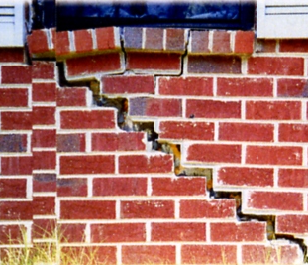
Case History
MISSISSIPPI BUILDER
17 years with good claims history
New subdivision with no Geotechnical Investigation
Yazoo Clay foundation soils
42 claims to date in subdivision covered under warranty
CAUSE:
Built directly on highly expansive soil because no Geotechnical Investigation
Notes:
Branded Page with bullet points

Slide 21
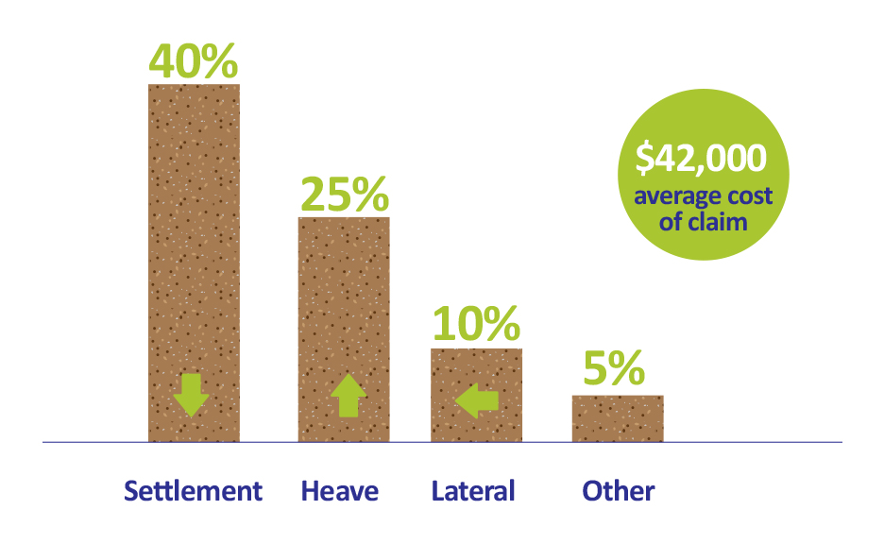
Types of foundation claims (80% of total)
Primary causes of structural claims
Fill Material
Swelling Soils
Notes:
Infographic

Slide 22
When do structural claims occur?

Slide 23
Structural defect Summary
Foundation is the greatest structural claim liability
Most structural damage occurs after first few years [80% after year 3]
Fill Material and Swelling Soils are primary causes
5 Best Practices to Avoid Structural Claims (Code)
Use Geotechnical Investigation, when necessary
Compact and test fill material
Design foundation for site conditions
Establish proper grades for drainage
Use gutters with 5-ft. extensions
Notes:
Branded Page with bullet points

Slide 24
Statute of Repose vs. Statute of Limitation
KEY LEGAL CONCEPTS & RISK MANAGEMENT
STRATEGIES FOR BUILDERS
Notes:
Multi-line Title with subtitle

Slide 25
Builder’s ‘practical’ Toolbox
Statute of Repose Is it finally over?
Express Warranty vs. Implied Warranty [good; bad]
Contract documents [remember: it’s contract; or TORT]
Marketing You said what?
Insurance Is your CGL doing it’s job? Good coverage? Is it coordinated with the warranty and other contracts to protect assets?
InsuranceSpecialtyGroup.com
Notes:
Branded Title Page version 2

Slide 26
Statute of Repose
“…Designed to bar actions after a specified period of time has run from the occurrence of an event…”
”
-Wikipedia
InsuranceSpecialtyGroup.com
Notes:
Branded Page with bullet points

Slide 27
Statute of Limitation
“
“…written laws passed to restrict the maximum time after an event that legal proceedings may be initiated…”
”
InsuranceSpecialtyGroup.com
Notes:
Quote Slide

Slide 28
Statute of Repose
“
“…is designed to bar actions after a specified period of time has run from the occurrence of some event…”
”
InsuranceSpecialtyGroup.com
Notes:
Quote Slide

Slide 29
Feeding Frenzy
“
The legal profession wants to form a symbiotic relationship with your business. You provide the exposed flesh. They’ll provide the butchers.
”
Builder Magazine – September 2001
Notes:
Quote Slide

Slide 30
Features and Benefits of APP
1. Written contract between builder and purchaser
2. Purchaser accepts warranty in lieu of implied warranty laws
3. Builder maintains construction defect liabilities in contract law (the warranty) vs. tort law (litigation)
4. Conciliation services for 10 years for disgruntled home owners
5. Mandatory arbitration for 10 years
6. CGL Claims Coordinate with the terms and conditions of the warranty
7. Insured Structural Defect coverage either through the Warranty (first dollar) or the CGL policy subject to CGL deductible
.
Notes:
Quote Slide

Slide 31
Contracts: Avoiding TORT and Litigation
BLUEPRINT TO PROTECT YOUR BUSINESS
Notes:
Multi-line Title with subtitle

